Slide 1
WINDOW APPLICATION
Report 1 (14/05/2016 – 20/05/2016)

Slide 2
Outline
A. Application Requirement
B. Programing Language, Framework and Demo
C. Bluetooth Research
D. Suggestion

Slide 3
A. Application Requirement
Pairing armband and PC via bluetooth connection
Getting and analyzing data from armband to recognize hand gestures.
Using set of 5 hand gestures to control presentation from Powerpoint
Let user see the battery level and manage armband connection (Optional)

Slide 4
B. Programing Language and Framework
Our application is developed by C#. We use C# because:
C# is a high-level programing language from Microsoft with sufficient library support for window application development.
Easy to design user-friendly software.
We use MVVM pattern in WPF framework
WPF: Window Presentation Foundation, popular framework to build window application.
MVVM: Model – View – ViewModel, easy to make any changes for the software.

Slide 5
C. Bluetooth Research
Why BLE?
A large number of BLE products sleep most of the time, waking up only to advertise and connect when needed. This means advertisements have a big impact on power consumption.
3 steps to make an app work with Bluetooth Low Energy device:
Advertising -> Connection -> Data Transfer

Slide 6
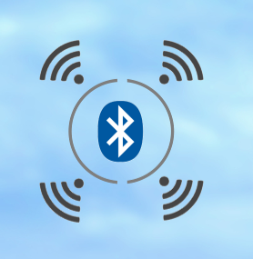
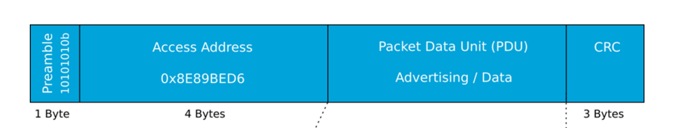
C. Bluetooth Research
Advertising
Peripheral Device (BLE): broadcasts packets to every device around it
Central Device (PC): act on the information to request connection with BLE Device

Slide 7
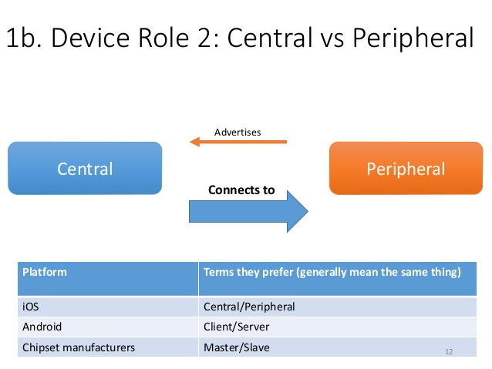
C. Bluetooth Research
Connection
A connection is established to allow two way communication between peripheral and central device.
BLE: will stop advertising itself, other devices will no longer be able to see it

Slide 8
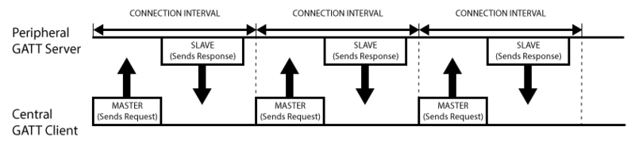
C. Bluetooth Research
Data Transfer
GATT (Generic Attribute Profile), and it defines the way that two Bluetooth Low Energy devices transfer data back and forth using concepts called Services and Characteristics.
Transaction
When establish connection:
_ GATT Server suggest “connection interval”
_ GATT Client try to reconnect every connection interval to see if any new data is available

Slide 9
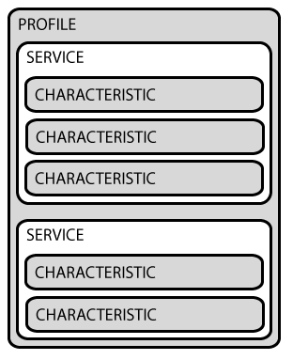
C. Bluetooth Research
GATT transactions are based on nested objects
Profile: is compiled by peripheral designers
E.x: Heart Rate Profile (HRP)
The Heart Rate Profile (HRP) enables a Collector device to connect and interact with a Heart Rate Sensor for use in fitness applications.
Services: each service distinguishes itself from other services by means of a unique numeric ID called a UUID, have one or more characteristic
E.x: Heart Rate Service has 3 characteristic: Heart Rate Measurement, Body Sensor Location, Heart Rate Control Point
Characteristic: encapsulates a single data point (contain an array of related data, such as X/Y/Z values from a 3-axis accelerometer, etc.).

Slide 10
C. Bluetooth Research
Solution:
#1: Use library support from Microsoft for BLE and GATT services
_ Window 8.1 and above.
#2: Use library support from bluetooth manufacturer

Slide 11
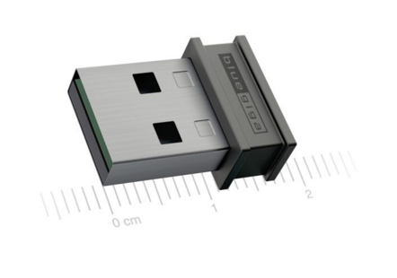
D. Suggestion
#1: Demo on Myo: App connect to Myo, get Myo data, then control presentation in Powerpoint
_ Bluegiga Bluetooth Device: BLED112
#2: Demo on CC2650:
CC2650
PC
(Powerpoint)
Buttons

Slide 12
Reference
http://www.argenox.com/bluetooth-low-energy-ble-v4-0-development/library/a-ble-advertising-primer/
https://learn.adafruit.com/introduction-to-bluetooth-low-energy/gatt
https://developer.bluetooth.org/TechnologyOverview/Pages/Profiles.aspx#GATT

